Slide 1
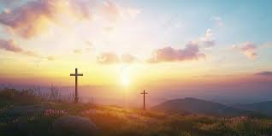
奇妙十架
When I Survey the Wondrous Cross
詩集：生命聖詩，122

Slide 2
每逢思念 奇妙十架， 榮耀救主 在上懸掛， 從前名利 富足 矜誇， 我看如土 完全撇下。
When I survey the wondrous cross, on which the Prince of glory died,
my richest gain I count but loss, and pour contempt on all my pride.

Slide 3
求主禁我 別有所誇， 只誇救主 捨身十架， 基督為我 獻身流血， 我願捨盡 虛空榮華。
Forbid it, Lord, that I should boast, save in the death of Christ, my God!
All the vain things that charm me most, I sacrifice them through his blood.

Slide 4
試看祂頭 祂足 祂手， 慈愛憂傷 和血並流， 從前可曾 愛憂交織？ 荊棘可曾 化作冕旒？
See, from his head, his hands, his feet, sorrow and love flow mingled down.
Did e'er such love and sorrow meet, or thorns compose so rich a crown?

Slide 5
宇宙萬物 若歸我有， 盡獻所有 何足報恩， 神聖大愛 奇妙難測， 願獻我命 我心 我身。
Were the whole realm of nature mine, that were a present far too small.
Love so amazing, so divine, demands my soul, my life, my all.

